Slide 1
Database Systems
Lecture 1-Chapter # 14
DATABASE DESIGN THEORY AND NORMALIZATION
Alina Arshad
alina.arshad@nu.edu.pk

Slide 2
Normalization
Normalization is the process of reorganizing/restructuring data in a database with a series of so called normal-forms, so that it meets two basic requirements:
There is no redundancy of data (all data is stored in only one place)
data dependencies are logical (all related data items are stored together).
Normalization is important for many reasons, but chiefly because it allows databases to take up as little disk space as possible, resulting in increased performance.

Slide 3
Four informal guidelines
Four informal guidelines used to determine the quality of relation schema design:
Making sure that the semantics of the attributes is clear in the schema
Reducing the redundant information in tuples
Reducing the NULL values in tuples
Disallowing the possibility of generating spurious tuples.

Slide 4
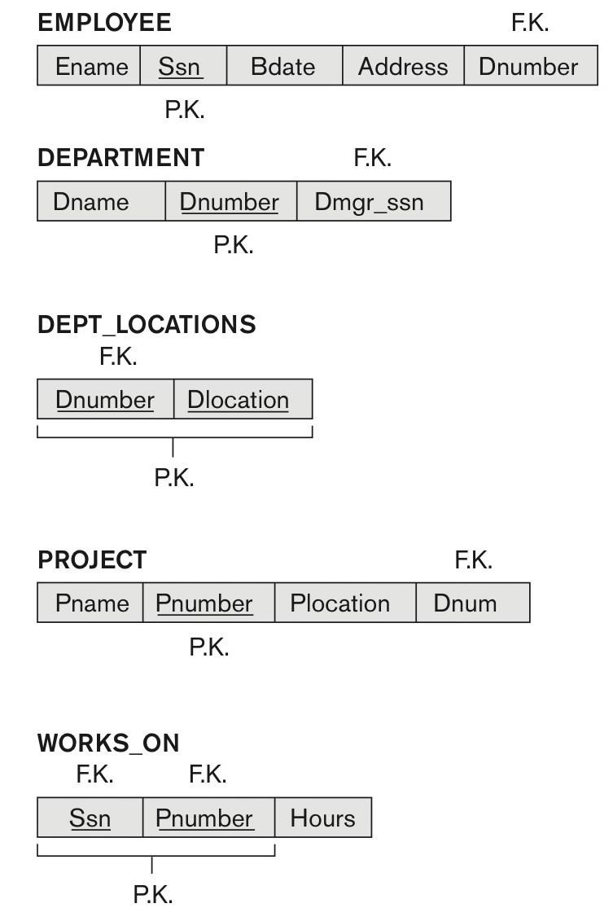
Figure 14.1 A simplified COMPANY relational database schema.

Slide 5
Guideline 1
Design a relation schema so that it is easy to explain its meaning.
Do not combine attributes from multiple entity types and relationship types into a single relation.
If the relation corresponds to a mixture of multiple entities and relationships, semantic ambiguities will result and the relation cannot be easily explained.

Slide 6
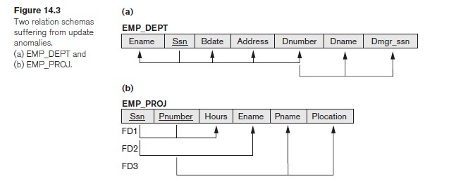
Examples of Violating Guideline 1.
Guideline 1 by mixing attributes from distinct real-world entities: EMP_DEPT mixes attributes of employees and departments, and EMP_PROJ mixes attributes of employees and projects and the WORKS_ON relationship.They fare poorly Against the above measure of design quality. They may be used as views, but they Cause problems when used as base relations,

Slide 7
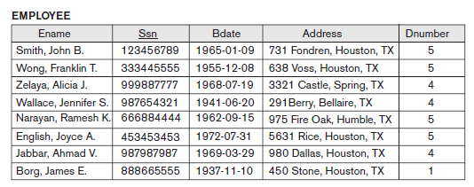
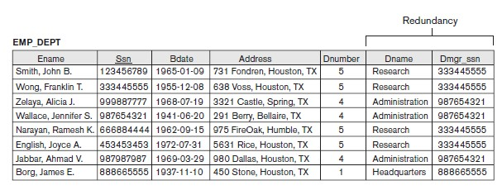
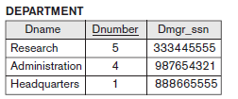
Redundant Information in Tuples and Update Anomalies
Goal of schema design: to minimize the storage space used by the base relations
Grouping attributes into relation schemas has a significant effect on storage space.
Natural join of Employee and Department Tables

Slide 8
Anomalies
Storing natural joins of base relations leads to an additional problem referred to as update anomalies.
These anomalies can be categorized into three types:
Insertion Anomalies
Deletion Anomalies
Update Anomalies.

Slide 9
Insertion Anomalies.
Insertion anomalies can be differentiated into two types:
To insert a new employee tuple into EMP_DEPT, we must include either the attribute values for the department that the employee works for, or NULLs (if the employee does not work for a department as yet).
For example, to insert a new tuple for an employee who works in department number 5, we must enter all the attribute values of department 5 correctly so that they are consistent

Slide 10
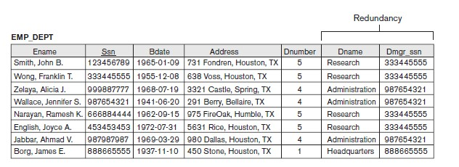
Insertion Anomalies.
For example, to insert a new tuple for an employee who works in department number 5, we must enter all the attribute values of department 5 correctly so that they are consistent
In the design of Figure 14.2, we do not have to worry about this consistency problem because we enter only the department number in the employee tuple; once in the database, as a single tuple in the DEPARTMENT relation.

Slide 11
Insertion Anomalies.
It is difficult to insert a new department that has no
employees as yet in the EMP_DEPT relation. The only way to do this is to place NULL values in the
This violates the entity integrity for EMP_DEPT because its primary
key Ssn cannot be null.

Slide 12
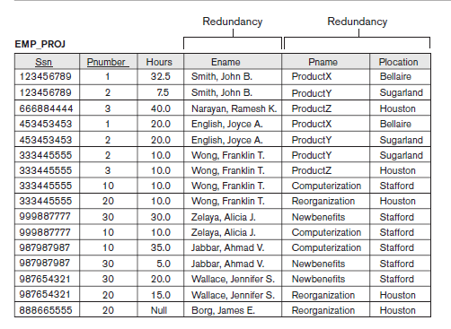
EXAMPLE OF AN INSERT ANOMALY
Consider the relation:
EMP_PROJ(Emp#, Proj#, Hours Ename, Pname,Plocation)
Insert Anomaly:
Cannot insert a project unless an employee is assigned to it.
Conversely
Cannot insert an employee unless an he/she is assigned to a project.

Slide 13
EXAMPLE OF AN UPDATE ANOMALY(Repeated Update)
Consider the relation:
EMP_PROJ(Emp#, Proj#, Hours Ename, Pname, Plocation)
Update Anomaly:
Changing the name of project number P1 from “ProjectX” to “Customer- Accounting” may cause this update to be made for all 100 employees working on project P1.

Slide 14
EXAMPLE OF A DELETE ANOMALY
Consider the relation:
EMP_PROJ(Emp#, Proj#, Hours Ename, Pname,Plocation)
Delete Anomaly:
When a project is deleted, it will result in deleting all the employees who work on that project.
Alternately, if an employee is the sole employee on a project, deleting that employee would result in deleting the corresponding project.

Slide 15
Guideline 2.
Guideline 2:
Design the base relation schemas so that no insertion, deletion, or modification anomalies are not present in the relations.

Slide 16
Null Values
If many of the attributes do not apply to all tuples in the relation, we end up with many NULLs in those tuples.
This can waste space at the storage level and may also lead to problems with understanding the meaning of the attributes.
Another problem with NULLs is how to account for them when aggregate operations such as COUNT or SUM are applied.

Slide 17
Reasons for NULLS
Attribute not applicable or invalid (e.g. Visa_Status may not apply to local students)
Value known to exist, but unavailable (e.g. Home_Phone_Number for an employee may exist, but may not be available and recorded yet.
Guideline 3. As far as possible, avoid placing attributes in a base relation whose values may frequently be NULL.
If NULLs are unavoidable, make sure that they apply in exceptional cases only and do not apply to a majority of tuples in the relation.

